Slide 1



Crop Advisor
“Optimizing Crops with Smart Fertilization”

Slide 2
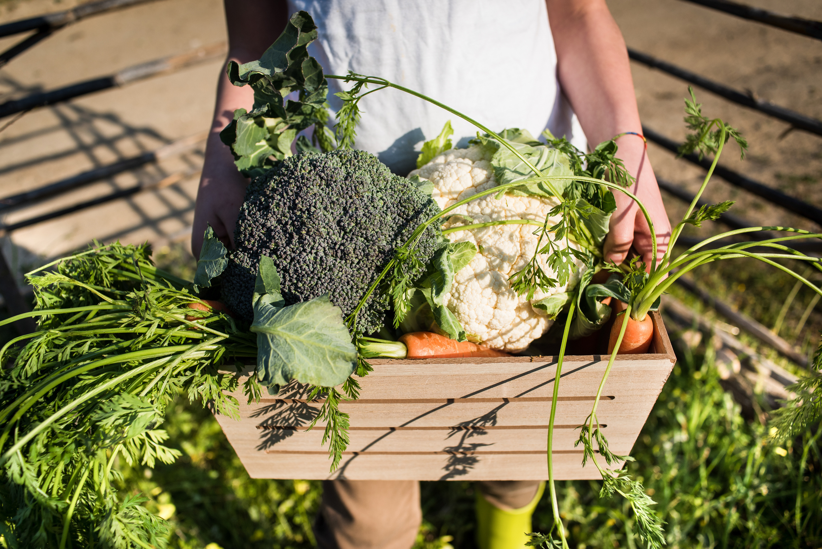
PROBLEM STATEMENT:
Limited access to accurate information about suitable crops based on local climate, soil, and temperature conditions hinders sustainable agricultural practices and reduces crop yield optimization for farmers.

Slide 3
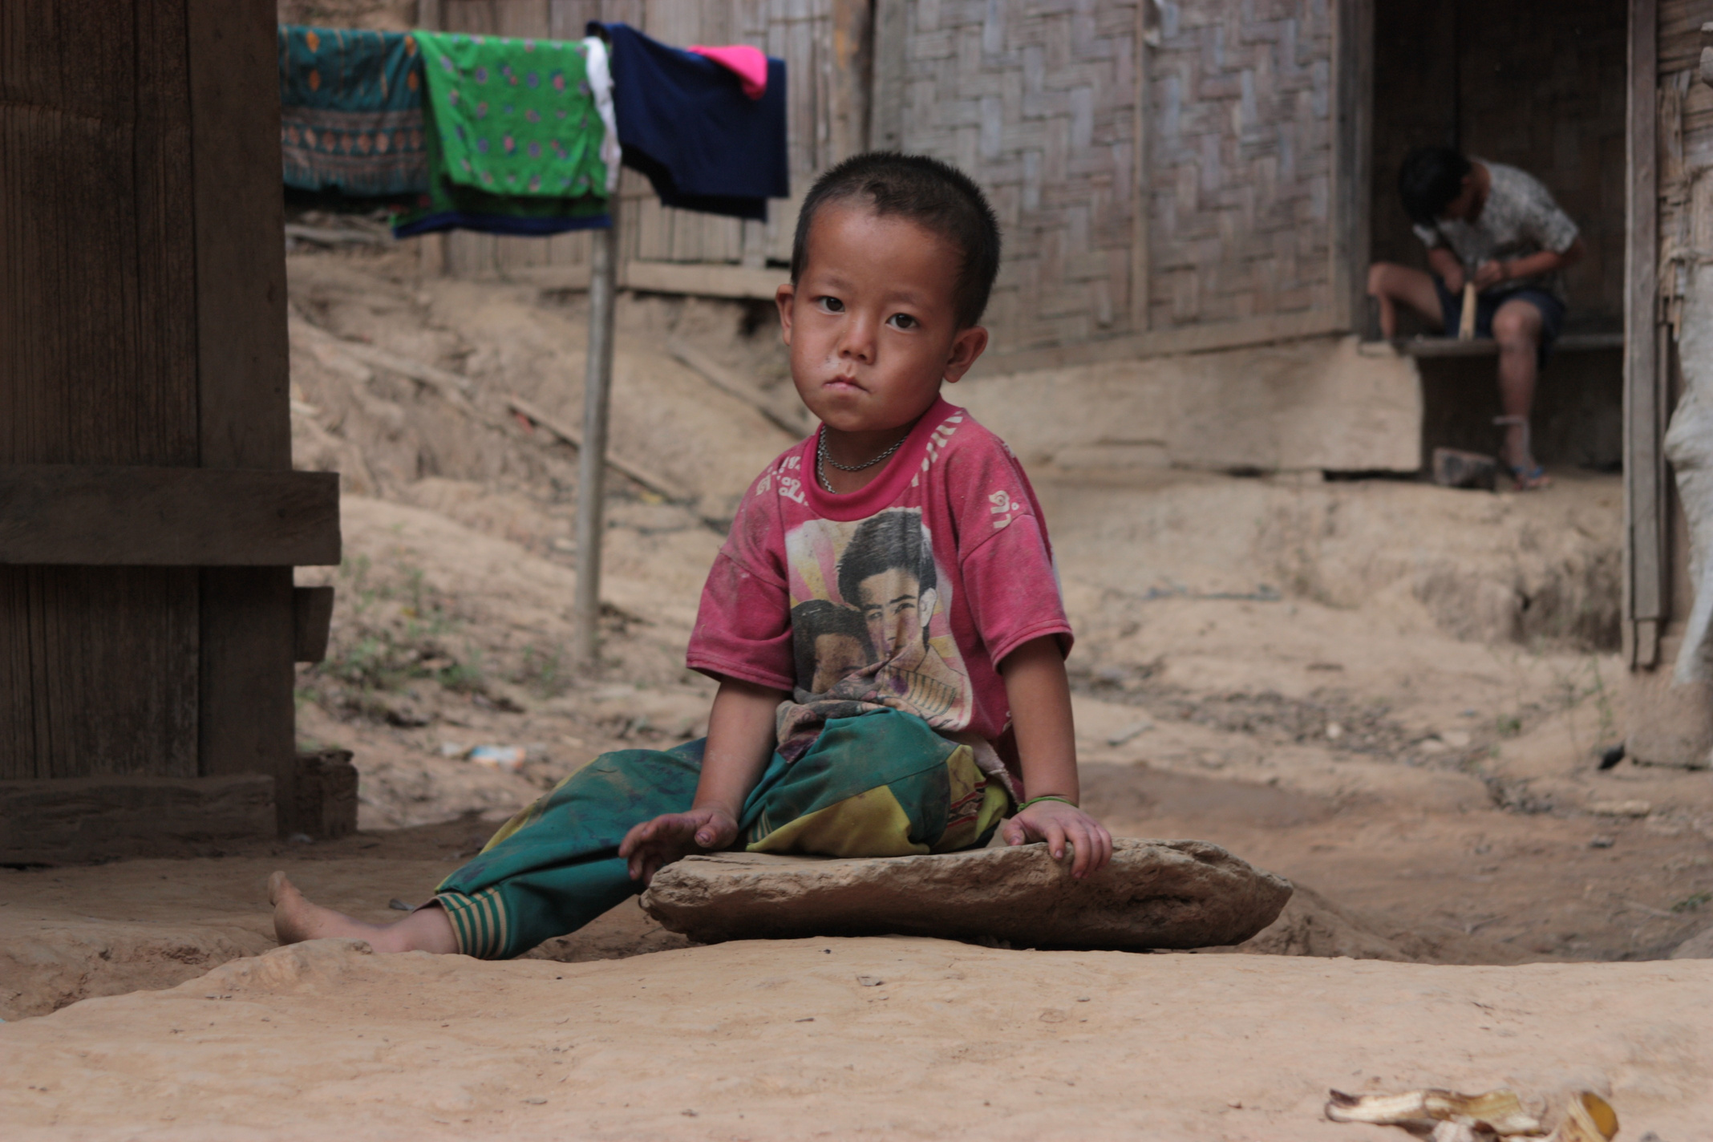

PRIORITY SDG:
Priority Goal and Targets :
“Sow seeds of change, reap a world without hunger.”
Enhancing crop suitability can contribute to increased agricultural productivity, ensuring food security, and promoting sustainable farming practices.
Sustainable Development Goals

Slide 4
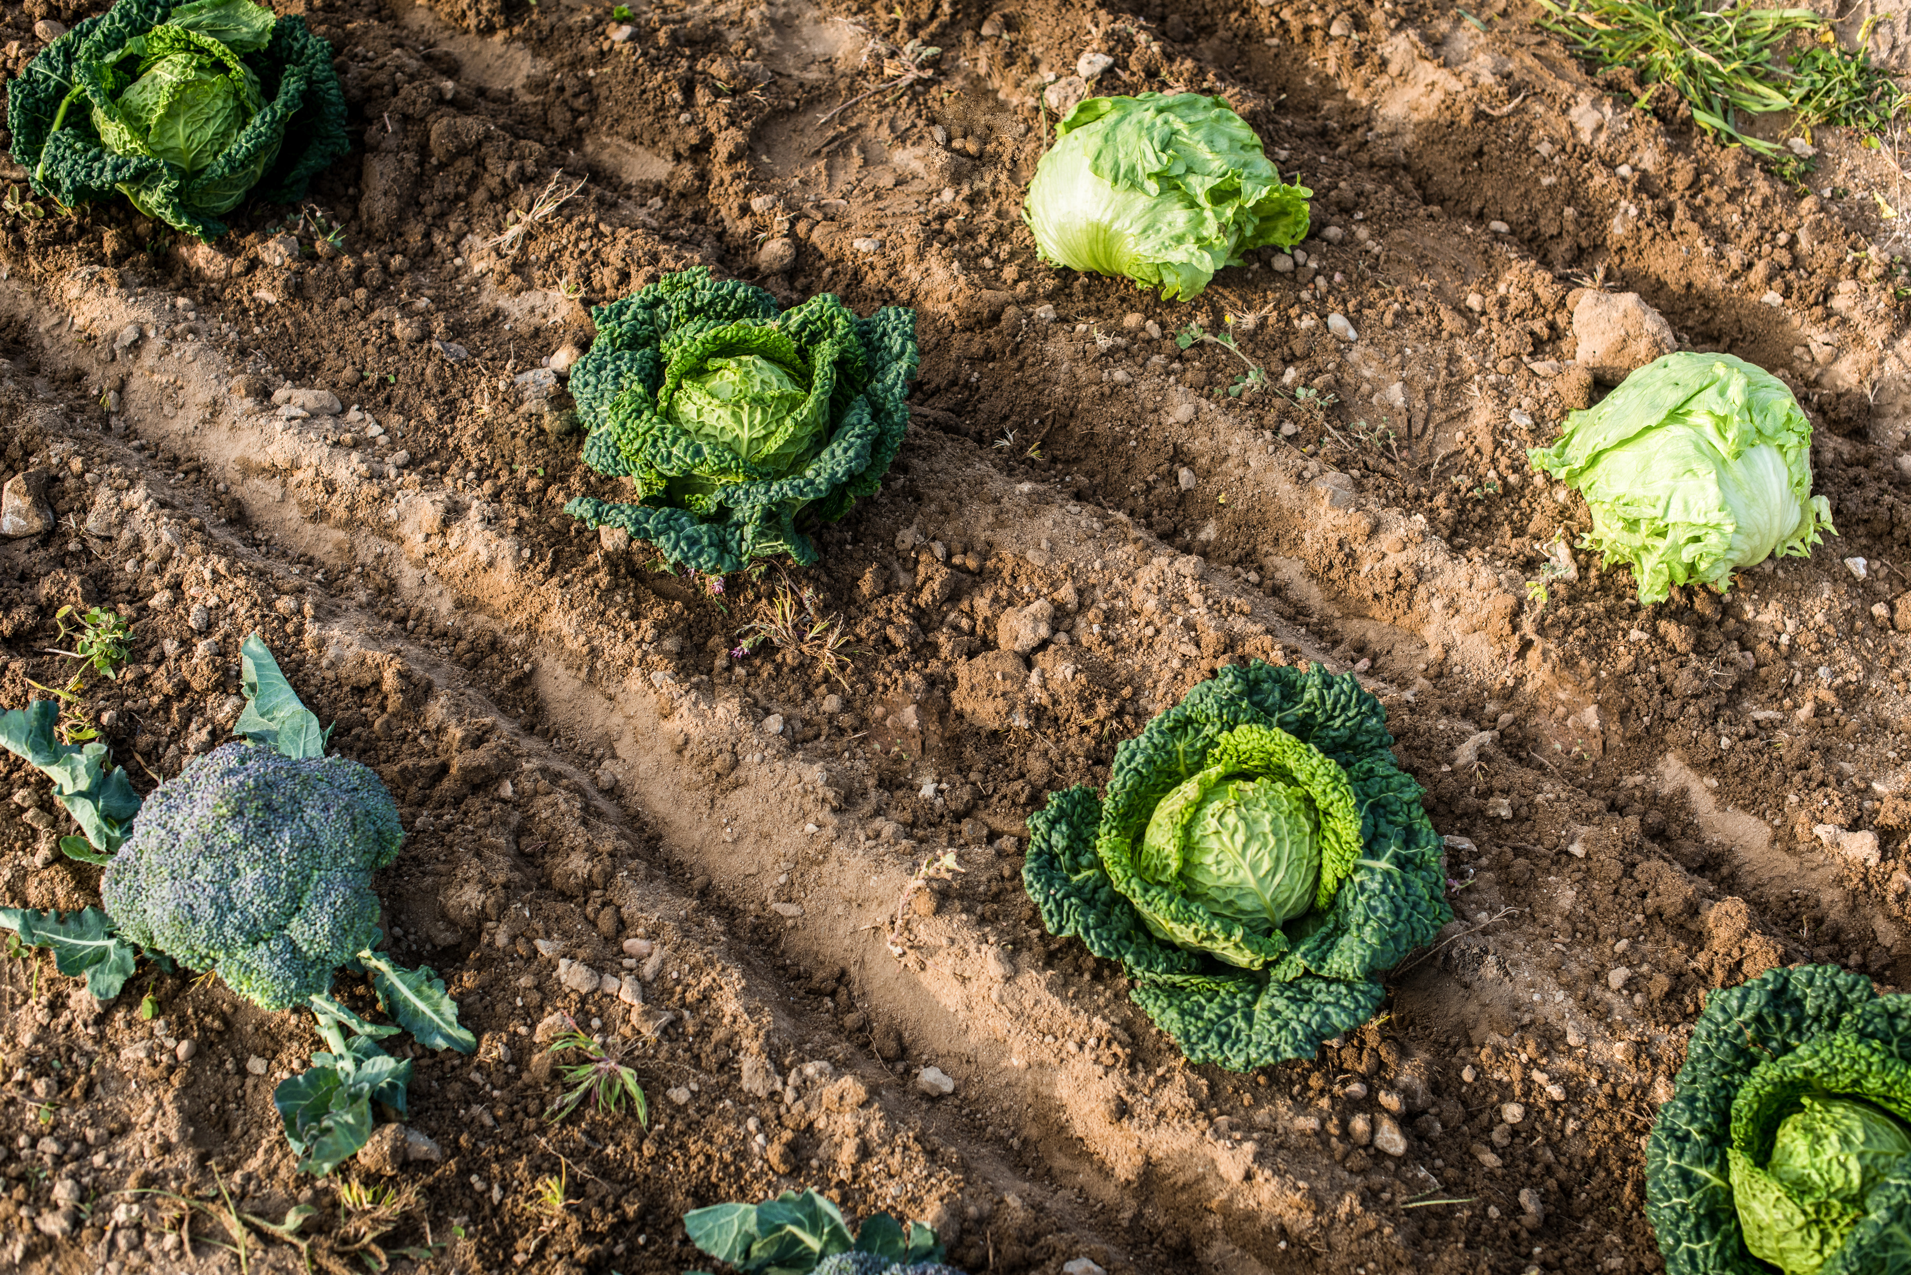
EMPATHY TOOL USED:
STORY TELLING:
By using storytelling as our empathy tool, we had a deeper understanding of the users' needs, preferences, and challenges. This understanding, in turn, contributes to the creation of a crop suitability advisor in the following ways:
Understanding User Perspectives:
It helped us to step into the shoes of farmers and other stakeholders. By narrating stories from the perspective of users, it becomes easier to empathize with their challenges and experiences.
Creating User Personas:
By weaving narratives around the daily lives, practices, and aspirations of farmers helped us create personas and
serve as a reference point during the development process, ensuring that the tool aligns with the real-world needs of its users.
"We identified prevailing challenges faced by farmers and obtained quantitative data from a reputable governmental source called Kaggle. This data offers insights into farmers' daily hurdles and decision-making processes."
TYPE OF RESEARCH:

Slide 5
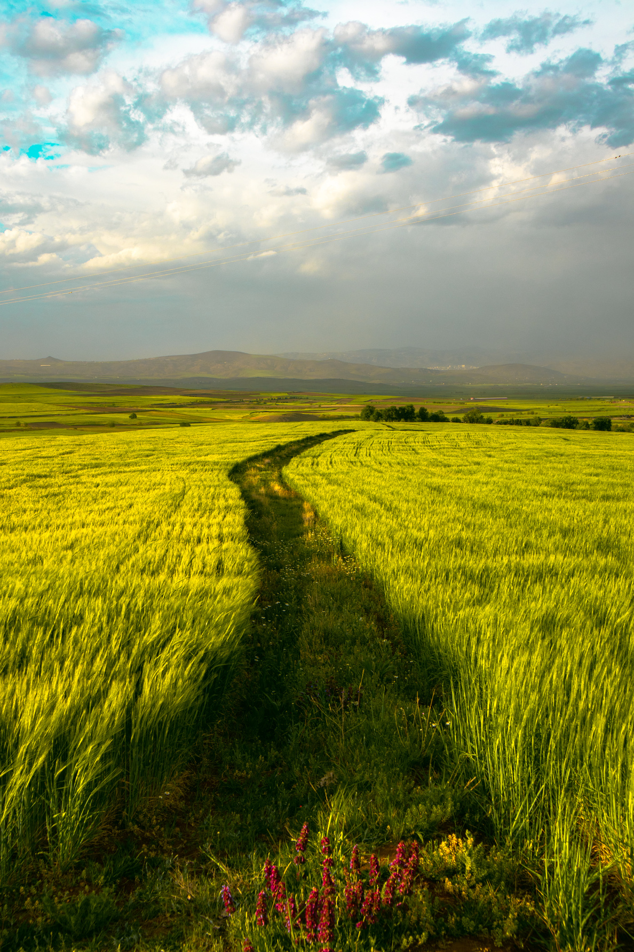
2. AEIOU:
ACTIVITIES:
Engaged in observational research to understand the daily activities of farmers, their farming practices, and decision-making processes related to crop selection.
Conducted interviews with farmers to gain insights into their experiences, challenges, and preferences in managing their fields.
ENVIRONMENT:
Immersed ourselves in the actual farming environment by and understanding the diverse environments in which farmers operate, including varying climate patterns, soil types, and agricultural practices.
INTERACTIONS:
Facilitated conversations to uncover shared challenges and innovative solutions.
Conducted usability testings to observe how they interact with prototypes or early versions of the crop advisor.

Slide 6

OBJECTS:
Educational materials, such as articles and tutorials are objects we engaged with to enhance the understanding of sustainable farming practices.
Included elements such as buttons and images that make up the user interface of the crop advisor.
USERS:
Understanding the diverse user groups is crucial for tailoring the crop advisor to meet the specific needs and contexts.
Regular feedback and collaboration with these users contribute to the ongoing improvement of the crop advisor.

Slide 7
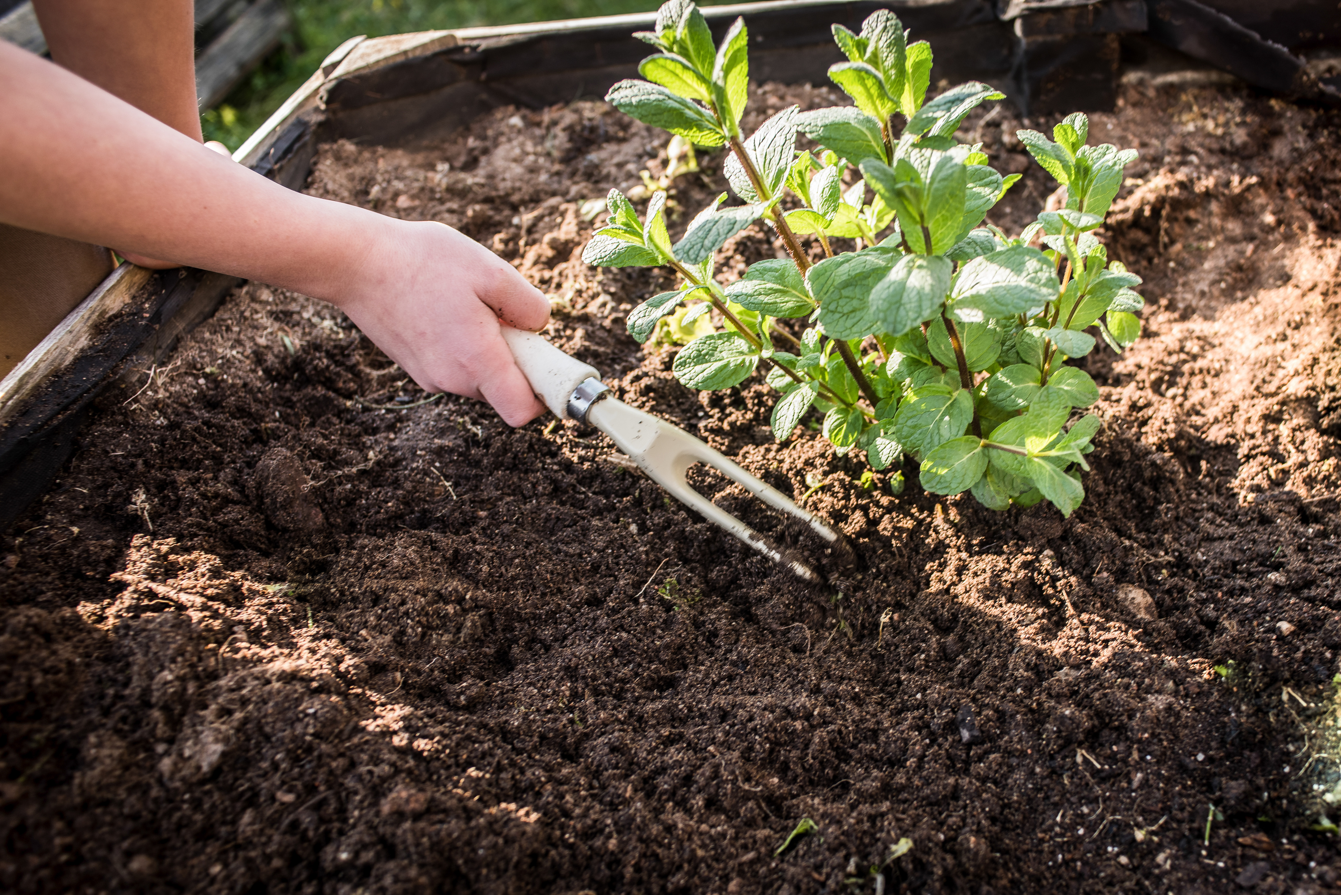
USERS:
MAINSTREAM USERS:
EXTREME USERS:
LEAD USERS:
(typical users who represent the broader target audience)
(represent the outliers or those with unique and extreme needs compared to the average user)
(individuals or entities that are ahead of the mainstream in adopting new practices or technologies)
1.Farmers:
Traditional farmers seeking guidance on optimal crop selection based on climate, soil, and temperature conditions.
1.Crop Consultants:
They adopt new technologies and methodologies to offer best advice to farmers.
2. AgTech Companies:
Companies develop and provide innovative solutions.
3. Researchers:
They are often involved in the development and evaluation of innovative tools and approaches.
1.Organic or Sustainable Agriculture Enthusiasts:
Those seeking crops that align with environmentally friendly and sustainable agriculture.

Slide 8

DEFINING INSIGHTS :
PRIMARY NEEDS:
SECONDARY NEEDS:
LATENT NEEDS:
Sustainability
Accurate Crop Recommendations: Farmers primarily need accurate and reliable recommendations on which crops are most suitable for their specific climate, soil, and temperature conditions.
User-Friendly Interface: It allows farmers, agricultural extension services, and other stakeholders to easily interact with the tool and obtain valuable information.
Real-Time Data: This enables farmers to receive up-to-date information on changing conditions that may affect crop suitability.
Customization Features: Some users may desire secondary features, such as the ability to customize recommendations based on specific preferences or additional factors unique to their farming practices.
Usability
Educational Resources: Latent needs could include the provision of educational resources within the tool, helping farmers understand the reasons behind specific recommendations and promoting sustainable farming practices.

Slide 9






SERVICE EXPERIENCE CYCLE:
1 - Awareness and Discovery:
2 - Inputting Farm Details:
3 - Viewing Recommendations:
4 - Feedback and Iteration:
5 - Community Engagement:
Pain Points:
Lack of awareness about the tool.
Limited access to information in rural areas.
Gains:
Increased awareness about
a valuable
agricultural tool.
Pain Points:
Limited knowledge
Gains:
More accurate crop recommendation
Pain Points:
Misinterpretation of results.
Lack of understanding
Gains:
Improved decision-making for crop selection.
Pain Points:
Lack of a user-friendly feedback mechanism.
Unaddressed concerns.
Gains:
Continuous improvement of the tool based on user feedback.
Pain Points:
Limited participation due to connectivity issues.
Gains:
Building a supportive farming community.

Slide 10

IDEATION METHOD USED:
BRAINSTORMING:
Objective:
Generate innovative ideas and solutions for the development of a crop suitability advisor that considers climate, soil, and temperature conditions.
Our Idea:
Predictive Analysis: Develop a protocol/tool that predicts long-term trends in climate and suggests crops suitable for the expected conditions.
In this brainstorming session we discussed about emphasizing user engagement, data accuracy, and adaptability to diverse farming environments. The next steps involve evaluating and refining these ideas to create a robust and user-centric tool.

Slide 11

SOLUTION PROTOTYPE:
We have developed a solution prototype that aims to optimize crop fertilization using smart technology.
Our solution is a software application that utilizes the Python language and interfaces to analyze soil data, crop characteristics, and environmental factors to generate customized fertilization recommendations.
The software interface is user-friendly and intuitive, allowing farmers to easily input their data and receive real-time recommendations. Utilizing the programming language Python enhances the efficiency and effectiveness in agriculture, enabling stakeholders to harness the power of data-driven insights for improved crop productivity and sustainability.
With our solution, farmers can optimize their fertilizer usage, reduce costs, and minimize environmental impact, ultimately leading to higher crop yields and sustainable farming practices.

Slide 12

DESIGN FOR ENVIRONMENT:
Sustainability of the Solution:
The solution presented takes into consideration the environmental impact of crop optimization through smart fertilization. By using data-driven techniques , the Python language and web technology, the solution aims to minimize the use of fertilizers, reducing the potential negative effects on the environment.

Slide 13


BENEFITS OF ADOPTING THE PROJECT:
📈
INCREASED PRODUCTIVITY
Optimizing nutrient management leads to higher crop yields and improved farm profitability.
💰
REDUCED COSTS
Effective nutrient usage minimizes wastage and lowers unnecessary expenditure on fertilizers.
♻️
SUSTAINABLE AGRICULTURE
Proper nutrient management practices contribute to the long-term sustainability of farming operations.
🔍
DATA-DRIVEN DECISIONS
By utilizing data analysis, farmers can make informed decisions to enhance crop quality and yield.

Slide 14
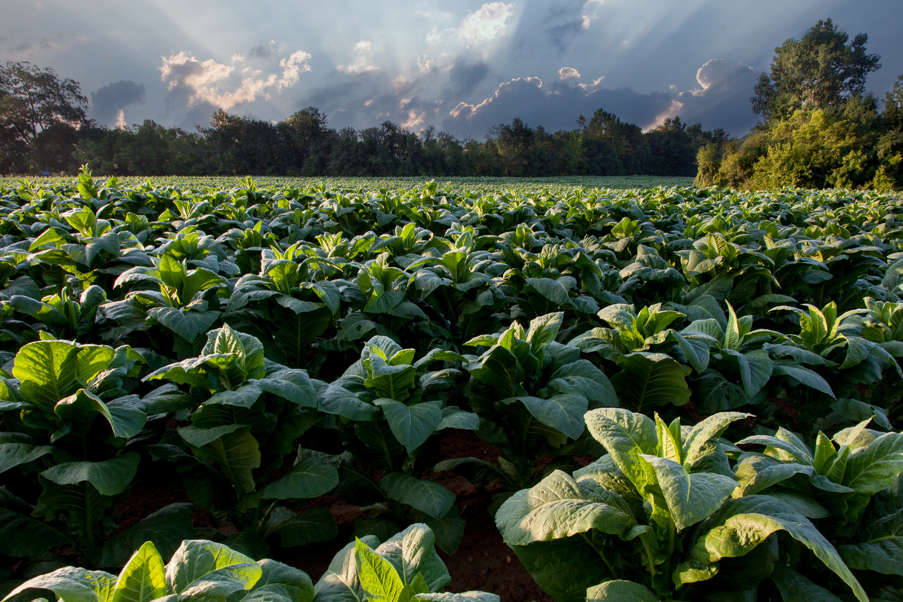
CONCLUSION:
"Crop Advisor" is a promising tool in agricultural decision-making, utilizing advanced technology to suggest optimal crops based on diverse environmental factors. The product's success lies in its ability to leverage machine learning algorithms to interpret data and offer tailored crop recommendations.
Its potential for the future is expansive. With further refinement and integration of more data sources, such as soil quality, pest predictions, and market trends, "Crop Advisor" could evolve into a comprehensive agricultural solution. Expansion into mobile applications or web platforms could enhance accessibility for farmers, making it more user-friendly and widely adopted.

Slide 15



THANK YOU

